Slide 1
Fun Finder
Java the Hut
Veronica Herzog, Nick Awtry, Tiffany Wu, & Michaela Moynihan

Slide 2
App Overview
Fun Finder is an event finding app
Allows the user to find/search for random events around them
Events are separated into categories
Sports, Arts, Food, Entertainment, Misc. (??)
User can choose the proximity of the events they can see based on user’s current location (??? are we still going to do this?)
User has option to create own event, with specified event location, type/ description, and time.
The user has the option to find events based off a physical map or a list of events near them

Slide 3
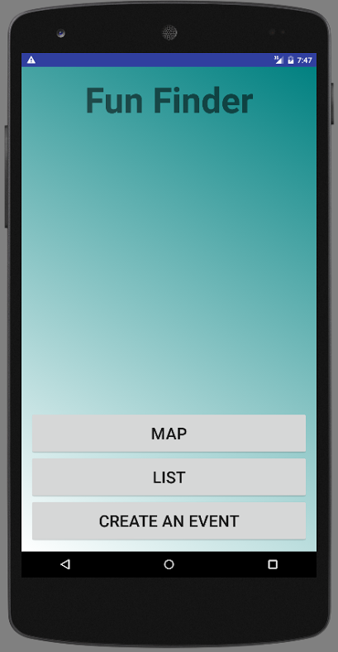
MAin Screen
The purpose of the main screen is to emphasize the logo/ “branding” of the app, as well as to give the user options right off the bat. The opening page has 3 options to click.
This button brings the user to a physical map with nearby events marked on it.
This button brings the user to a list of events nearby in order of proximity.
This button allows the user to create an event of their own and put it on a map for other interested users nearby

Slide 4
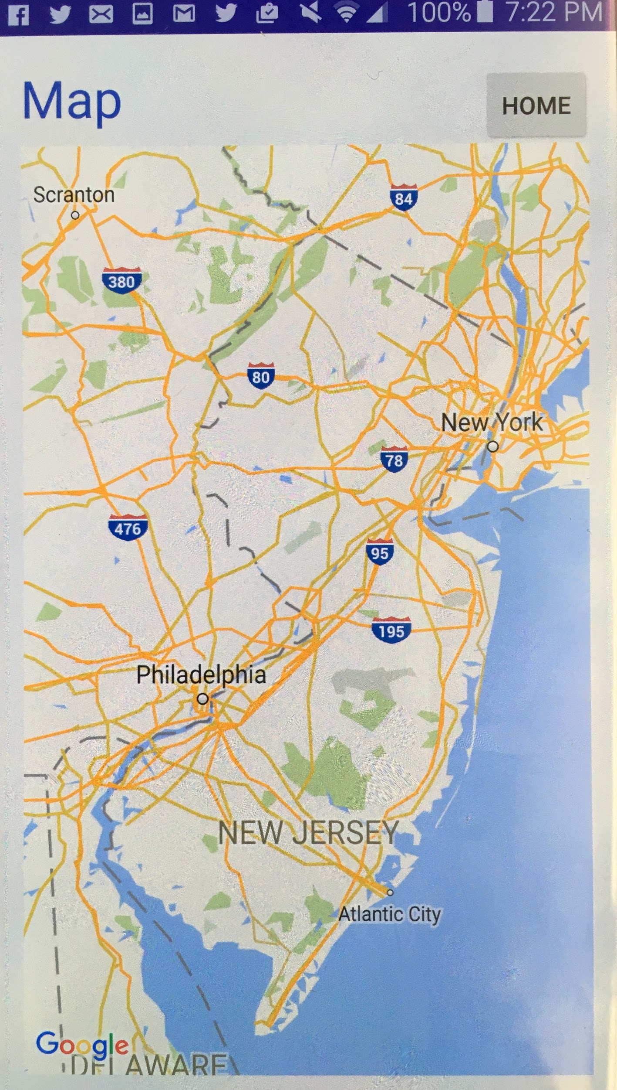
Map
The map page incorporates the Google Maps’ map. The map has pins of marked events on it that can be clicked on and expanded. When expanded, the event name and description pops up, as well as the time.
Brings user back to main page
Events marked on map

Slide 5
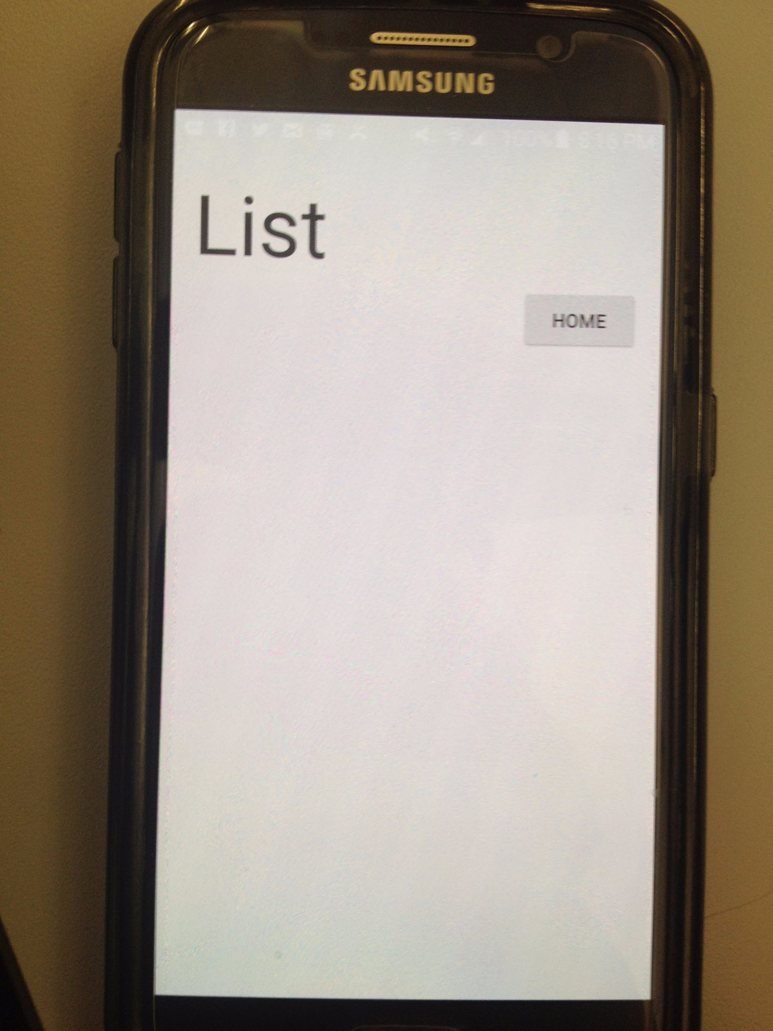
List
The list page has a list of all the events around the user. The list is in order of proximity to the user, and shows the user the location of the event.
Brings user back to main page
This space is allotted for a list of events around the user.

Slide 6
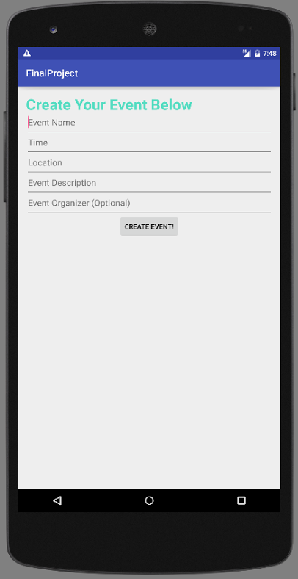
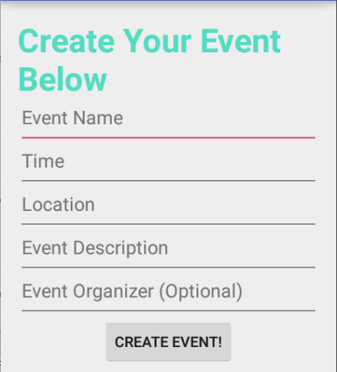
Create An Event
The purpose of the Create An Event page is to allow the user to create an event of their own. The create an event page has just 5 details about the event that the user has to fill out.
User inputs the name of the event.
User inputs the time of the event.
User inputs the location of the even. This includes address, city, state, and zipcode. (?? IS THIS WHAT WE DECIDED?)
User inputs a little blurb of the event.
User inputs has option to say who they are.

